Slide 1
Mobile Tracker
Kamron Javaherpour Jeffrey Lassen KyungBum Lee Parth Patel Anan Mallik
Kenneth Evensen

Slide 2
Mobile Tracker
- What is Mobile Tracker?
- Mobile Tracker is a web application that allows parent or care-taker to watch over
their child by simply opening a web browser.
- The goal of this project is to reduce child's dependency to the parent while
providing a sense of safety.
- Who needs Mobile Tracker?
- Parent and care-taker of a child with special needs can take a great advantage of
this project.
- Anyone who needs care and attention from distance away.
- How does Mobile Tracker contributes to our society?
- Easiness to keep track of child's whereabouts.
- Prediction: Less criminal activities.
- Requirements
- Access to Internet (Parent)
- Win7 Phone. (Child)

Slide 3
Objectives
1. A monitor application on the child's phone to track the child using GPS.
2. A website that records the location data provided by the mobile phone.
3. The ability for the user to define alerts for destinations, routes and
loitering.
a. If a destination is not reached by a certain time the user is notified on
the webpage (SMS optional).
b. If a route is deviated from the user is notified on the webpage. (SMS
optional).
c. If location doesn't change for set amount of time the user is notified on the
webpage (SMS optional).

Slide 4
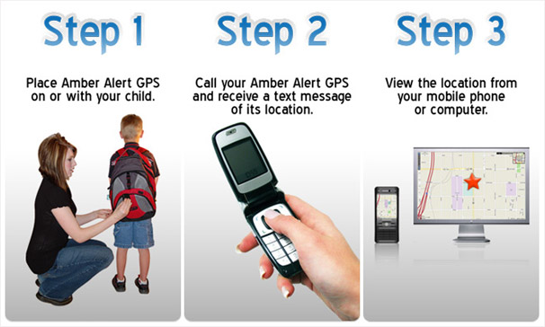
Operation Scenario
1) Parent starts the application from child's Win7 Phone.
2) Parent access the webpage and setup the routes with 2 addresses, how far his/her child can be apart from the route, timer to keep track of loitering activity, and time period for child to reach from starting point of route to the ending point of route.
3) Win7 Phone starts reporting to the server with current location every 5 seconds.
4) Web browser will load a map from Google. Indicate the route by a colored line, and indicate the current location of the child.

Slide 5
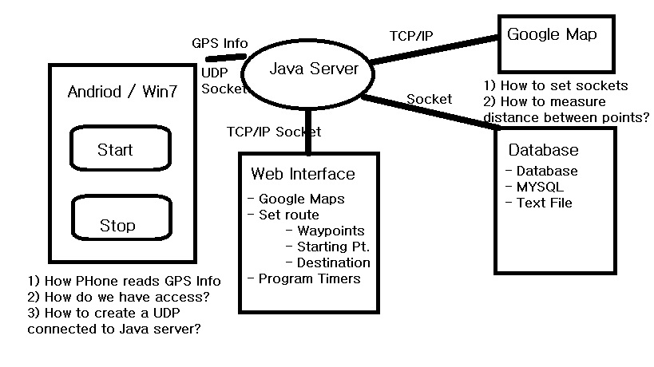
Analysis and Design

Slide 6

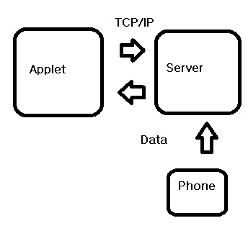
Implementation
Mobile Phone
Server Side
Web Interface

Slide 7
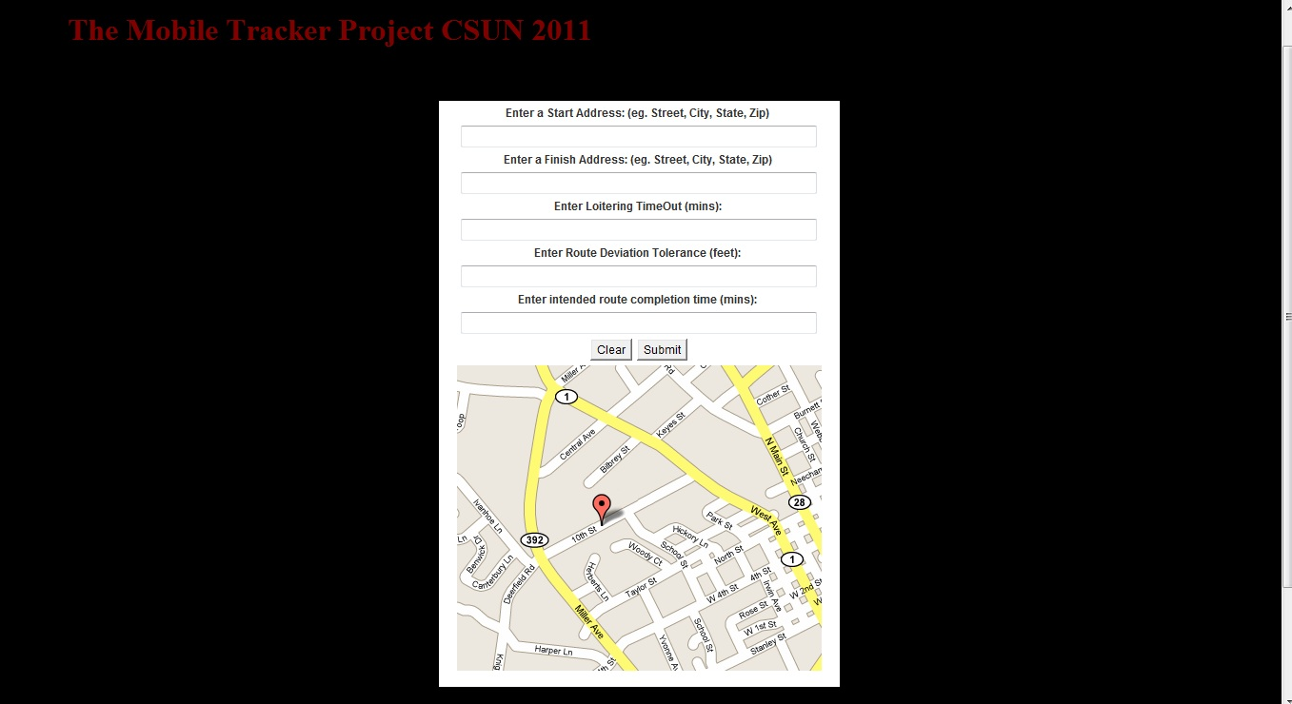

Slide 8
Teamwork and Credits
1) What did we learn from this project?
- Learned to work under pressure, competitive environment
- Win7 Phone / Android
- Team work
2) What challenges did we encounter?
- Windows 7 phone does not allow socket programming
- Time Management
- Web Interface
3) Opinions
- About people with disabilities
- About ourselves as computer scientist/engineer/student.

Slide 9


